Slide 1



Slide 2

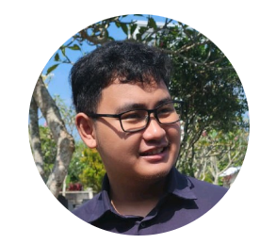
Hello 👋
Kaenova Mahendra Auditama
Tech Lead – Kerjago
Bangkit 2022 Distinction Graduate
Machine Learning Path
Connect with me!
Github: https://github.com/kaenova
LinkedIn: https://www.linkedin.com/in/kaenova/

Slide 3
Sebelum Mulai 📒
Sesi tanya jawab akan diadakan padi sesi tersendiri.
Untuk menanyakan berdasarkan konteks slide,
catat dan gunakan halaman slide
Adapun contoh kode yang dapat dilihat pada
Github dengan melakukan checkout ke tag
yang tertulis

Slide 4
Let’s Begin
🚀

Slide 5
Topics for Today
Pengenalan dan Pembuatan API pada HTTP
Studi kasus management Orang
Mengamankan API
Dokumentasi API
Sesi Pertanyaan akan dibuka setiap topik

Slide 6

Pengenalan dan Pembuatan API menggunakan HTTP

Slide 7
Beberapa Istilah Penting!
API - Application Programming Interface
Istilah dimana kita dapat menggunakan suatu aplikasi yang diprogram
HTTP - Hypertext Transfer Protocol (HTTP)
Protokol yang digunakan untuk melakukan transfer data hanya dengan menggunakan text (HyperText)

Slide 8
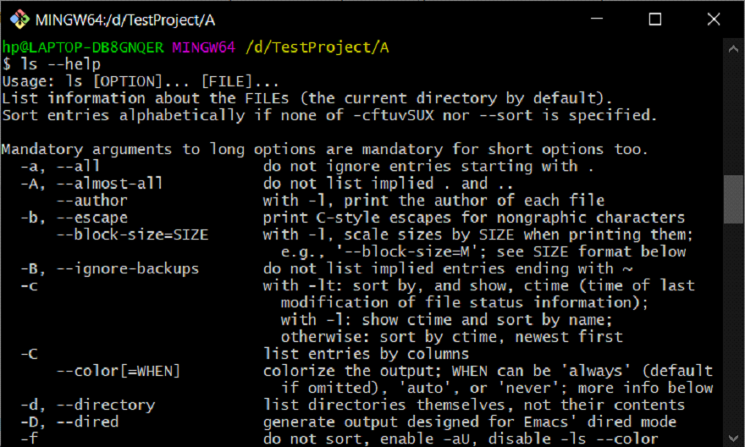
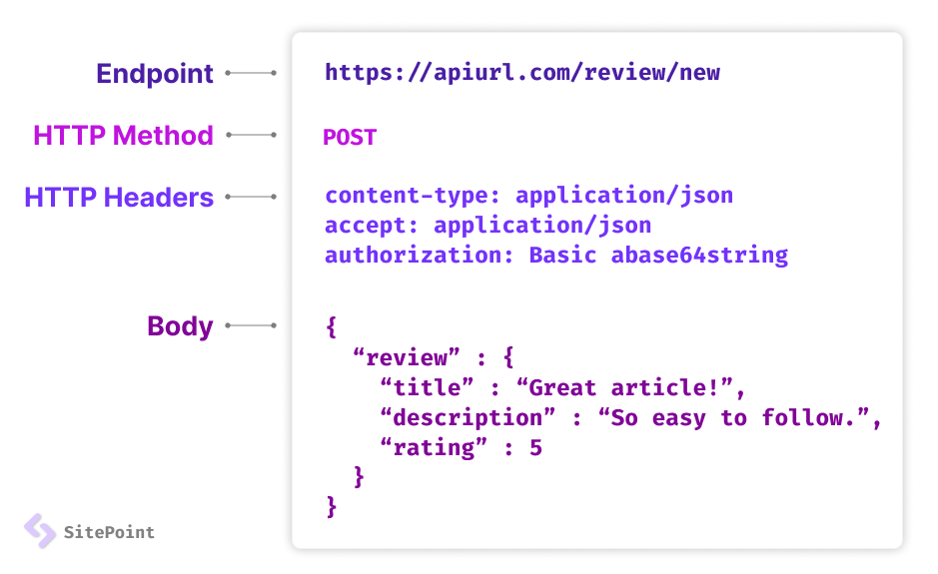
Ada banyak cara untuk membuat suatu API
API - CLI
API - HTTP

Slide 9

Begini Cara Website Bekerja
API - HTTP

Slide 10
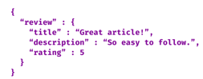
Endpoint
Berawalan dengan /
/review/new
Bagian HTTP yang terpenting
Method
GET, POST, PATCH, DELETE
POST
Body
Text, JSON, HTML

Slide 11

Pertanyaan?

Slide 12
A little Games! 🎮
POST https://kerjago.id/users/new
Method: ? Endpoint: ?

Slide 13
A little Games! 🎮
POST https://kerjago.id/users/new
Method: POST Endpoint: /users/new
GET https://bangkit.academy/
Method: ? Endpoint: ?

Slide 14
A little Games! 🎮
POST https://kerjago.id/users/new
Method: POST Endpoint: /users/new
GET https://bangkit.academy/
Method: GET Endpoint: /
PATCH localhost:3000/newUser
Method: ? Endpoint: ?

Slide 15
A little Games! 🎮
POST https://kerjago.id/users/new
Method: POST Endpoint: /users/new
GET https://bangkit.academy/
Method: GET Endpoint: /
PATCH localhost:3000/newUser
Method: PATCH Endpoint: /newUser
DELETE localhost:3000/user/30
Method: ? Endpoint: ?

Slide 16
A little Games! 🎮
POST https://kerjago.id/users/new
Method: POST Endpoint: /users/new
GET https://bangkit.academy/
Method: GET Endpoint: /
PATCH localhost:3000/newUser
Method: PATCH Endpoint: /newUser
DELETE localhost:3000/user/30
Method: DELETE Endpoint: /user/30

Slide 17
Let’s Code!

Slide 18

const express = require('express')
const app = express()
const port = 3000
app.get('/', (req, res) => {
res.send('Hello World!')
})
app.listen(port, () => {
console.log(`Example app listening on http://localhost:${port}`)
})

Slide 19
const express = require('express')
const app = express()
const port = 3000
// vvv Method
// vvv Endpoint
app.get('/', (req, res) => {
res.send('Hello World!')
// ^^^^^^^^^^^^^^ body
})
app.listen(port, () => {
console.log(`Example app listening on http://localhost:${port}`)
})

Slide 20
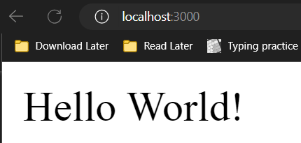
const express = require('express')
const app = express()
const port = 3000
// vvv Method
// vvv Endpoint
app.get('/', (req, res) => {
res.send('Hello World!')
// ^^^^^^^^^^^^^^ body
})
app.listen(port, () => {
console.log(`Example app listening on http://localhost:${port}`)
})

Slide 21
const express = require('express')
const app = express()
const port = 3000
app.get('/', (req, res) => {
res.send('Hello World!')
})
app.get('/hi', (req, res) => {
res.send('Hi World!')
})
app.listen(port, () => {
console.log(`Example app listening on http://localhost:${port}`)
})

Slide 22

const express = require('express')
const app = express()
const port = 3000
app.get('/', (req, res) => {
res.send('Hello World!')
})
app.get('/hi', (req, res) => {
res.send('Hi World!')
})
app.listen(port, () => {
console.log(`Example app listening on http://localhost:${port}`)
})

Slide 23
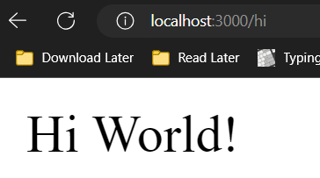
const express = require('express')
const app = express()
const port = 3000
app.get('/', (req, res) => {
res.send('Hello World!')
})
app.get('/hi', (req, res) => {
res.send('Hi World!')
})
app.listen(port, () => {
console.log(`Example app listening on http://localhost:${port}`)
})

Slide 24
Pertanyaan?
😎

Slide 25
Studi kasus management Kontak

Slide 26
Kasus Apa Saja yang Akan Dibuat
Melihat Kontak yang tersedia
Menambahkan kontak
Menghapus Kontak
Update kontak
Menambahkan kontak tapi harus login 🤣

Slide 27
Melihat Kontak Yang Tersedia

Slide 28
const express = require('express')
const app = express()
const port = 3000
app.get('/', (req, res) => {
res.send('Hello World!')
})
app.get('/hi', (req, res) => {
res.send('Hi World!')
})
app.listen(port, () => {
console.log(`Example app listening on http://localhost:${port}`)
})

Slide 29
const express = require('express')
const { getContact } = require('./utils')
const app = express()
const port = 3000
app.get('/', (req, res) => {
res.send('Hello World!')
})
app.get('/getContact', (req, res) => {
const data = getContact()
return res.json(data)
})
app.listen(port, () => {
console.log(`Example app listening on http://localhost:${port}`)
})

Slide 30
const express = require('express')
const { getContact } = require('./utils')
const app = express()
const port = 3000
app.get('/', (req, res) => {
res.send('Hello World!')
})
app.get('/getContact', (req, res) => {
const data = getContact()
return res.json(data)
})
app.listen(port, () => {
console.log(`Example app listening on http://localhost:${port}`)
})
function getContact() {
let jsonData = fs.readFileSync('data.json')
let data = JSON.parse(jsonData)
return data
}

Slide 31
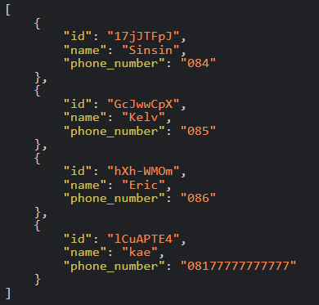
const express = require('express')
const { getContact } = require('./utils')
const app = express()
const port = 3000
app.get('/', (req, res) => {
res.send('Hello World!')
})
app.get('/getContact', (req, res) => {
const data = getContact()
return res.json(data)
})
app.listen(port, () => {
console.log(`Example app listening on http://localhost:${port}`)
})
function getContact() {
let jsonData = fs.readFileSync('data.json')
let data = JSON.parse(jsonData)
return data
}

Slide 32
Menambah Kontak

Slide 33
const express = require('express')
const { getContact } = require('./utils')
const app = express()
const port = 3000
app.get('/', (req, res) => {
res.send('Hello World!')
})
app.get('/getContact', (req, res) => {
const data = getContact()
return res.json(data)
})
app.listen(port, () => {
console.log(`Example app listening on http://localhost:${port}`)
})

Slide 34
const express = require('express')
const { getContact } = require('./utils')
const app = express()
...
app.get('/getContact', (req, res) => {
const data = getContact()
return res.json(data)
})
...

Slide 35
const express = require('express')
const { getContact, addContact } = require('./utils')
const app = express()
...
app.get('/getContact', (req, res) => {
const data = getContact()
return res.json(data)
})
app.post('/addContact', (req, res) => {
addContact(???, ???)
return res.send('Berhasil menambahkan kontak')
})
...
function addContact(name, phoneNumber) {
let id = nanoid(8)
let jsonData = fs.readFileSync('data.json')
let data = JSON.parse(jsonData)
data.push({
"id": id,
"name": name,
"phone_number": phoneNumber
})
jsonData = JSON.stringify(data)
fs.writeFileSync('data.json', jsonData)
}

Slide 36
const express = require('express')
const { getContact, addContact } = require('./utils')
const app = express()
...
app.get('/getContact', (req, res) => {
const data = getContact()
return res.json(data)
})
app.post('/addContact', express.json(), (req, res) => {
const name = req.body.name
const phoneNumber = req.body.phoneNumber
addContact(name, phoneNumber)
return res.send('Berhasil menambahkan kontak')
})
...

Slide 37
const express = require('express')
const { getContact, addContact } = require('./utils')
const app = express()
...
app.get('/getContact', (req, res) => {
const data = getContact()
return res.json(data)
})
// Digunakan untuk mengambil input dari user
// vvvv vvvvvvvvvvvvvv
app.post('/addContact', express.json(), (req, res) => {
const name = req.body.name
const phoneNumber = req.body.phoneNumber
addContact(name, phoneNumber)
return res.send('Berhasil menambahkan kontak')
})
...

Slide 38
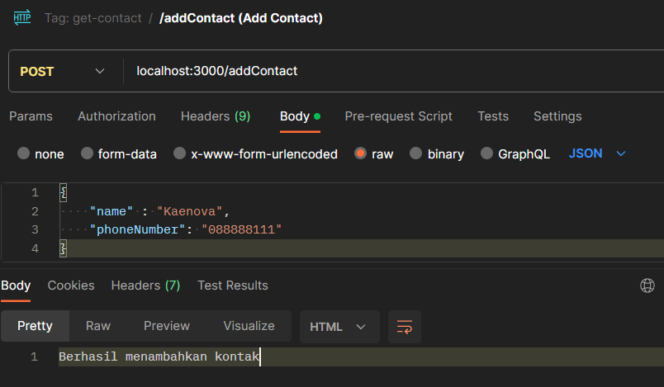
...
app.post('/addContact', express.json(), (req, res) => {
const name = req.body.name
const phoneNumber = req.body.phoneNumber
addContact(name, phoneNumber)
return res.send('Berhasil menambahkan kontak')
})
...

Slide 39

Let’s Break

Slide 40
Menghapus Kontak

Slide 41
const express = require('express')
const { getContact, addContact } = require('./utils')
const app = express()
...
app.post('/addContact', express.json(), (req, res) => {
const name = req.body.name
const phoneNumber = req.body.phoneNumber
addContact(name, phoneNumber)
return res.send('Berhasil menambahkan kontak')
})
...

Slide 42
const express = require('express')
const { getContact, addContact, deleteContact } = require('./utils')
const app = express()
...
app.post('/addContact', express.json(), (req, res) => {
const name = req.body.name
const phoneNumber = req.body.phoneNumber
addContact(name, phoneNumber)
return res.send('Berhasil menambahkan kontak')
})
...
function deleteContact(id) {
let jsonData = fs.readFileSync('data.json')
let data = JSON.parse(jsonData)
// search through data by looping
const index = data.findIndex((temp) => temp.id === id)
if (index === -1) {
return false
}
data.splice(index, 1)
jsonData = JSON.stringify(data)
fs.writeFileSync('data.json', jsonData)
return true
}

Slide 43
const express = require('express')
const { getContact, addContact, deleteContact } = require('./utils')
const app = express()
...
app.post('/addContact', express.json(), (req, res) => {
const name = req.body.name
const phoneNumber = req.body.phoneNumber
addContact(name, phoneNumber)
return res.send('Berhasil menambahkan kontak')
})
app.delete('/deleteContact', express.json(), (req, res) => {
const id = req.body.id
if (deleteContact(id)) {
return res.send('Berhasil menghapus kontak')
} else {
return res.send("Gagal menghapus kontak")
}
})
...

Slide 44
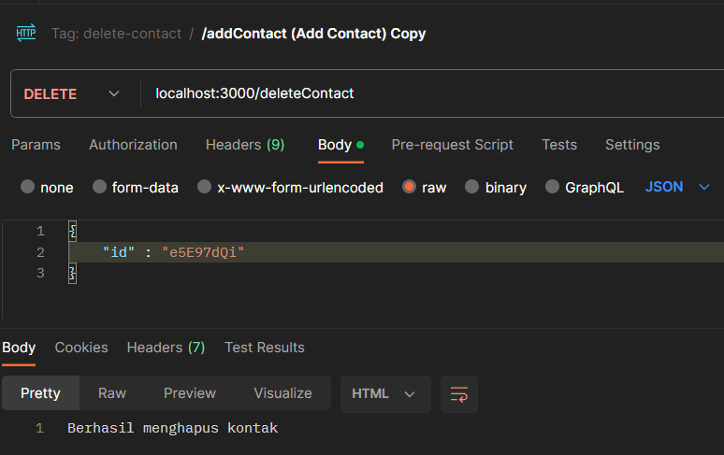
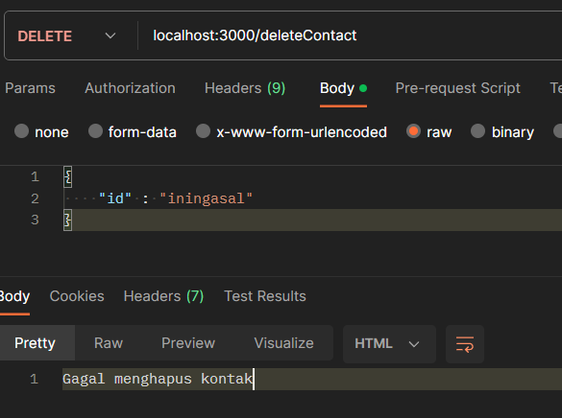
const express = require('express')
const { getContact, addContact, deleteContact } = require('./utils')
const app = express()
...
app.delete('/deleteContact', express.json(), (req, res) => {
const id = req.body.id
if (deleteContact(id)) {
return res.send('Berhasil menghapus kontak')
} else {
return res.send("Gagal menghapus kontak")
}
})
...

Slide 45
Update Kontak

Slide 46
function updateContact(id, name, phoneNumber) {
let jsonData = fs.readFileSync('data.json')
let data = JSON.parse(jsonData)
// search through data by looping
const index = data.findIndex((temp) => temp.id === id)
if (index === -1) {
return false
}
data[index].name = nama
data[index].phoneNumber = phoneNumber
jsonData = JSON.stringify(data)
fs.writeFileSync('data.json', jsonData)
return true
}

Slide 47
const express = require('express')
const { getContact, addContact, deleteContact, updateContact } = require('./utils')
const app = express()
...
app.patch('/updateContact', express.json(), (req, res) => {
const id = req.body.id
const name = req.body.name
const phoneNumber = req.body.phoneNumber
if (updateContact(id, name, phoneNumber)) {
return res.send('Berhasil mengupdate kontak')
} else {
return res.send("Gagal mengupdate kontak")
}
})
...

Slide 48
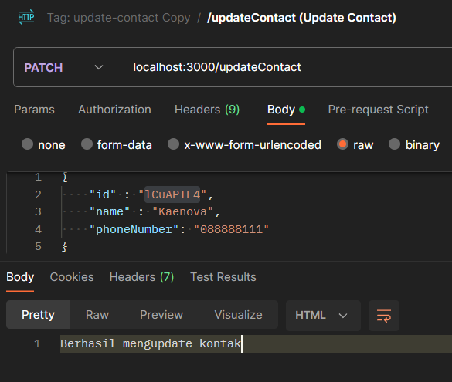
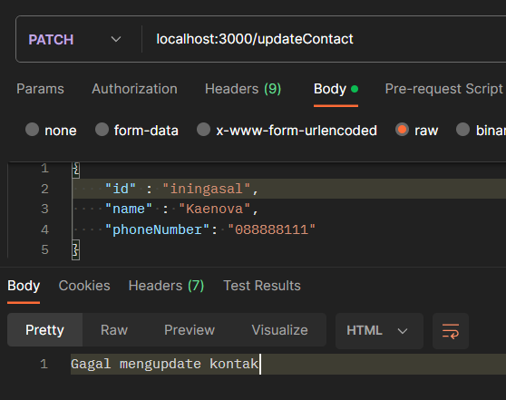
const express = require('express')
const { getContact, addContact, deleteContact, updateContact } = require('./utils')
const app = express()
...
app.patch('/updateContact', express.json(), (req, res) => {
const id = req.body.id
const name = req.body.name
const phoneNumber = req.body.phoneNumber
if (updateContact(id, name, phoneNumber)) {
return res.send('Berhasil mengupdate kontak')
} else {
return res.send("Gagal mengupdate kontak")
}
})
...

Slide 49
So far....

Slide 50
app.get('/getContact', (req, res) => {
const data = getContact()
return res.json(data)
})
app.post('/addContact', express.json(), (req, res) => {
const name = req.body.name
const phoneNumber = req.body.phoneNumber
addContact(name, phoneNumber)
return res.send('Berhasil menambahkan kontak')
})
app.delete('/deleteContact', express.json(), (req, res) => {
const id = req.body.id
if (deleteContact(id)) {
return res.send('Berhasil menghapus kontak')
} else {
return res.send("Gagal menghapus kontak")
}
})
app.patch('/updateContact', express.json(), (req, res) => {
const id = req.body.id
const name = req.body.name
const phoneNumber = req.body.phoneNumber
if (updateContact(id, name, phoneNumber)) {
return res.send('Berhasil mengupdate kontak')
} else {
return res.send("Gagal mengupdate kontak")
}
})

Slide 51
app.get('/contact', (req, res) => {
const data = getContact()
return res.json(data)
})
app.post('/contact', express.json(), (req, res) => {
const name = req.body.name
const phoneNumber = req.body.phoneNumber
addContact(name, phoneNumber)
return res.send('Berhasil menambahkan kontak')
})
app.delete('/contact', express.json(), (req, res) => {
const id = req.body.id
if (deleteContact(id)) {
return res.send('Berhasil menghapus kontak')
} else {
return res.send("Gagal menghapus kontak")
}
})
app.patch('/contact', express.json(), (req, res) => {
const id = req.body.id
const name = req.body.name
const phoneNumber = req.body.phoneNumber
if (updateContact(id, name, phoneNumber)) {
return res.send('Berhasil mengupdate kontak')
} else {
return res.send("Gagal mengupdate kontak")
}
})

Slide 52

Pertanyaan?

Slide 53
Menambahkan kontak tapi harus login 🤣

Slide 54
Mari kita melihat bagaimana cara menambahkan kontak dari yang sudah dibuat

Slide 55
app.post('/contact', express.json(), (req, res) => {
const name = req.body.name
const phoneNumber = req.body.phoneNumber
addContact(name, phoneNumber)
return res.send('Berhasil menambahkan kontak')
})
Mari kita melihat bagaimana cara menambahkan kontak dari yang sudah dibuat

Slide 56
app.post('/contact', express.json(), (req, res) => {
// Butuh penjagaan penggunaan
const name = req.body.name
const phoneNumber = req.body.phoneNumber
addContact(name, phoneNumber)
return res.send('Berhasil menambahkan kontak')
})
Mari kita melihat bagaimana cara menambahkan kontak dari yang sudah dibuat

Slide 57
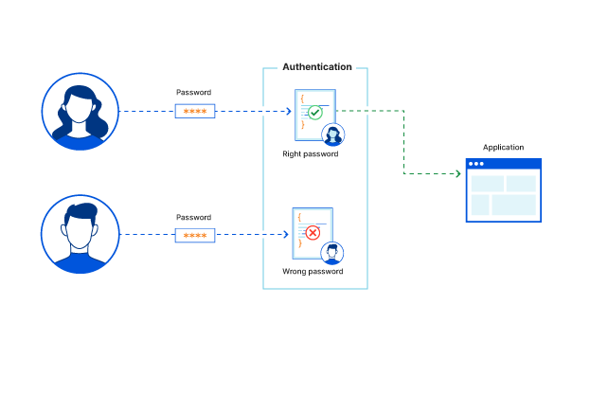
Apa itu Login
Untuk apa?

Slide 58
User
Server
1. Login dengan
Email dan password
2. Server Memberikan
Kode Unik yang bisa digunakan
3. Daftar Kontak baru
Dengan membawa kode unik
3. Permintaan User Diterima / Digagalkan

Slide 59
app.post('/contact', express.json(), (req, res) => {
// Butuh penjagaan penggunaan
const name = req.body.name
const phoneNumber = req.body.phoneNumber
addContact(name, phoneNumber)
return res.send('Berhasil menambahkan kontak')
})
Butuh Kode unik yang diberikan oleh server sebagai penjagaan

Slide 60
const serverKeyWord = 'apa hayoo'
app.post('/contact', express.json(), (req, res) => {
// Butuh penjagaan login
const userKeyWord = req.body.keyWord
if (userKeyWord !== serverKeyWord) {
return res.send('Anda tidak diperbolehkan menggunakan API ini')
}
const name = req.body.name
const phoneNumber = req.body.phoneNumber
addContact(name, phoneNumber)
return res.send('Berhasil menambahkan kontak')
})
Butuh Kode unik yang diberikan oleh server sebagai penjagaan

Slide 61
const serverKeyWord = 'apa hayoo'
app.post('/contact', express.json(), (req, res) => {
// Butuh penjagaan login
const userKeyWord = req.body.keyWord
if (userKeyWord !== serverKeyWord) {
return res.send('Anda tidak diperbolehkan menggunakan API ini')
}
const name = req.body.name
const phoneNumber = req.body.phoneNumber
addContact(name, phoneNumber)
return res.send('Berhasil menambahkan kontak')
})
app.post('/login', express.json(), (req, res) => {
const email = req.body.email
const password = req.body.password
// Sebagai contoh pengecekkan email dan password
// Lebih aman dengan disimpan di database serta password
// yang di encrypt dgn bcrypt
if (email === 'kaenova' && password == 'kerjago') {
return res.send(serverKeyWord)
}
return res.send("Anda salah password")
})

Slide 62
Dengan konsep yang sama,
Gunakan penjagaan menggunakan JWT untuk membuat kode unik dan memverifikasi kode tersebut
https://github.com/kaenova/teach-basic-api
git clone https://github.com/kaenova/teach-basic-api.git
git checkout authentication-jwt

Slide 63

Pertanyaan?

Slide 64
Document Your HTTP API!

Slide 65
Kita akan gunakan Postman dari kode yang dibuat
app.get('/', (req, res) => {
res.send('Hello World!')
})
app.get('/contact', (req, res) => {
const data = getContact()
return res.json(data)
})
app.post('/contact', express.json(), (req, res) => {
// Butuh penjagaan login
try {
const userKeyWord = req.body.keyWord
jwt.verify(userKeyWord, serverSecret)
} catch (e) {
return res.send('Anda tidak diperbolehkan menggunakan API ini')
}
const name = req.body.name
const phoneNumber = req.body.phoneNumber
addContact(name, phoneNumber)
return res.send('Berhasil menambahkan kontak')
})
app.delete('/contact', express.json(), (req, res) => {
const id = req.body.id
if (deleteContact(id)) {
return res.send('Berhasil menghapus kontak')
} else {
return res.send("Gagal menghapus kontak")
}
})
app.patch('/contact', express.json(), (req, res) => {
const id = req.body.id
const name = req.body.name
const phoneNumber = req.body.phoneNumber
if (updateContact(id, name, phoneNumber)) {
return res.send('Berhasil mengupdate kontak')
} else {
return res.send("Gagal mengupdate kontak")
}
})
app.post('/login', express.json(), (req, res) => {
const email = req.body.email
const password = req.body.password
// Sebagai contoh pengecekkan email dan password
// Lebih aman dengan disimpan di database serta password
// yang di encrypt dgn bcrypt
if (email === 'kaenova@bangkit.academy' && password == 'kerjago') {
return res.send(jwt.sign({ email: email }, serverSecret))
}
return res.send("Anda salah password")
})
app.listen(port, () => {
console.log(`Example app listening on http://localhost:${port}`)
})

Slide 66

Live Demo using Postman!

Slide 67

QnA
Session!

Slide 68

That’s It
Thank You! 👋
Feedback are welcomed!
https://bit.ly/kae-mentor-feedback
Connect with me!
Github: https://github.com/kaenova
LinkedIn: https://www.linkedin.com/in/kaenova/

